Slide 1
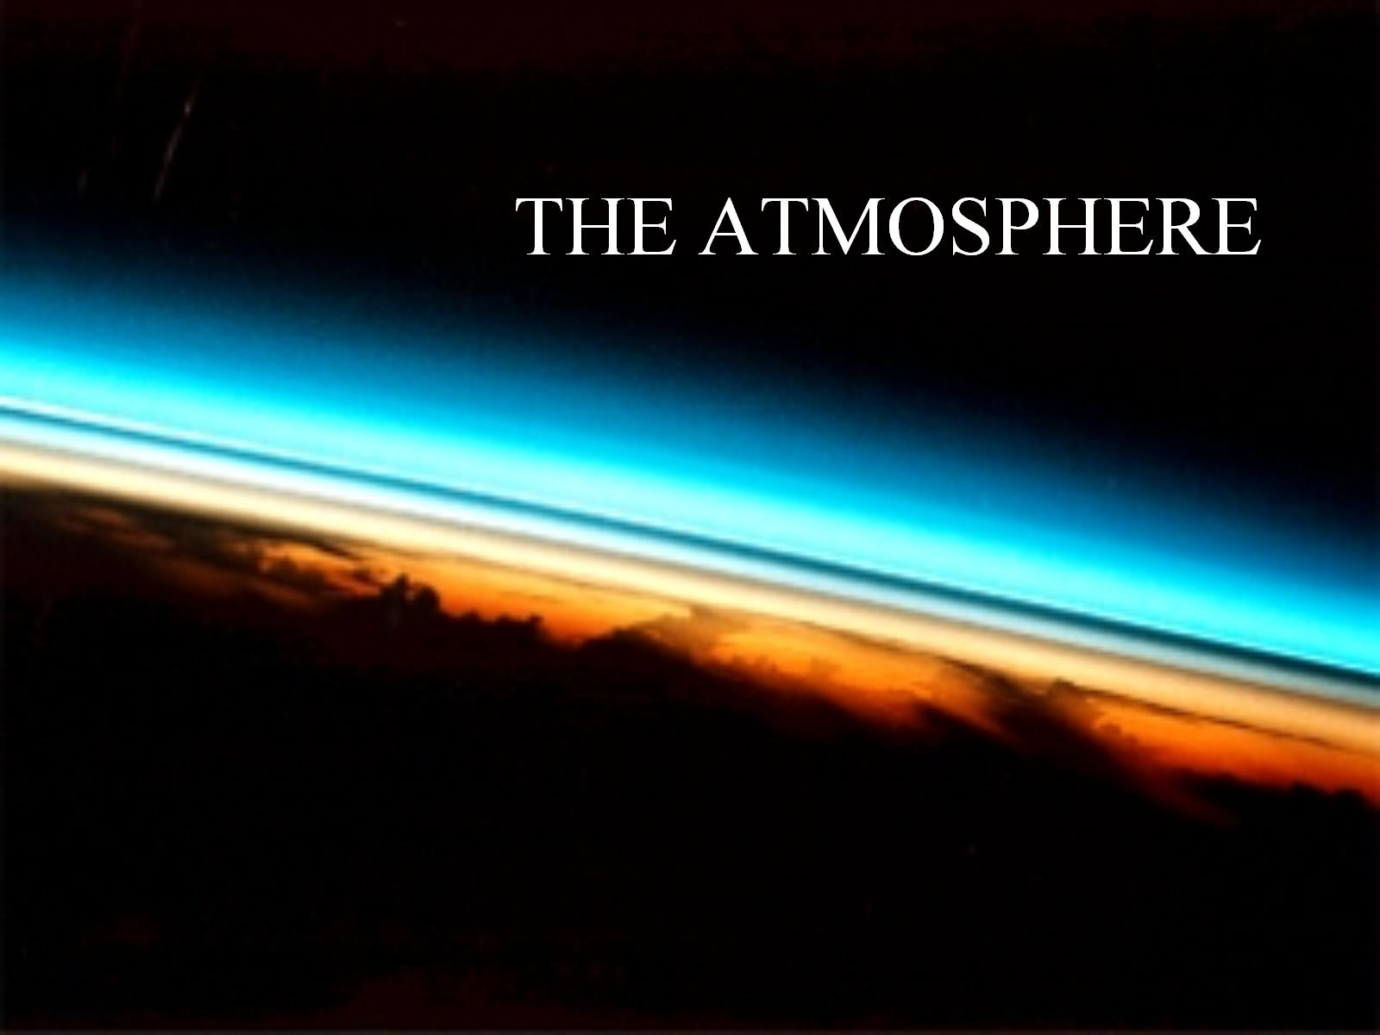
THE ATMOSPHERE

Slide 2
Without an atmosphere that had a specific design, life would not be possible on earth.

Slide 3
Our ancient climate was very different from today’s . . .

Slide 4
Our ancient climate was very different from today’s . . .

Slide 5
Our ancient climate was very different from today’s . . .

Slide 7
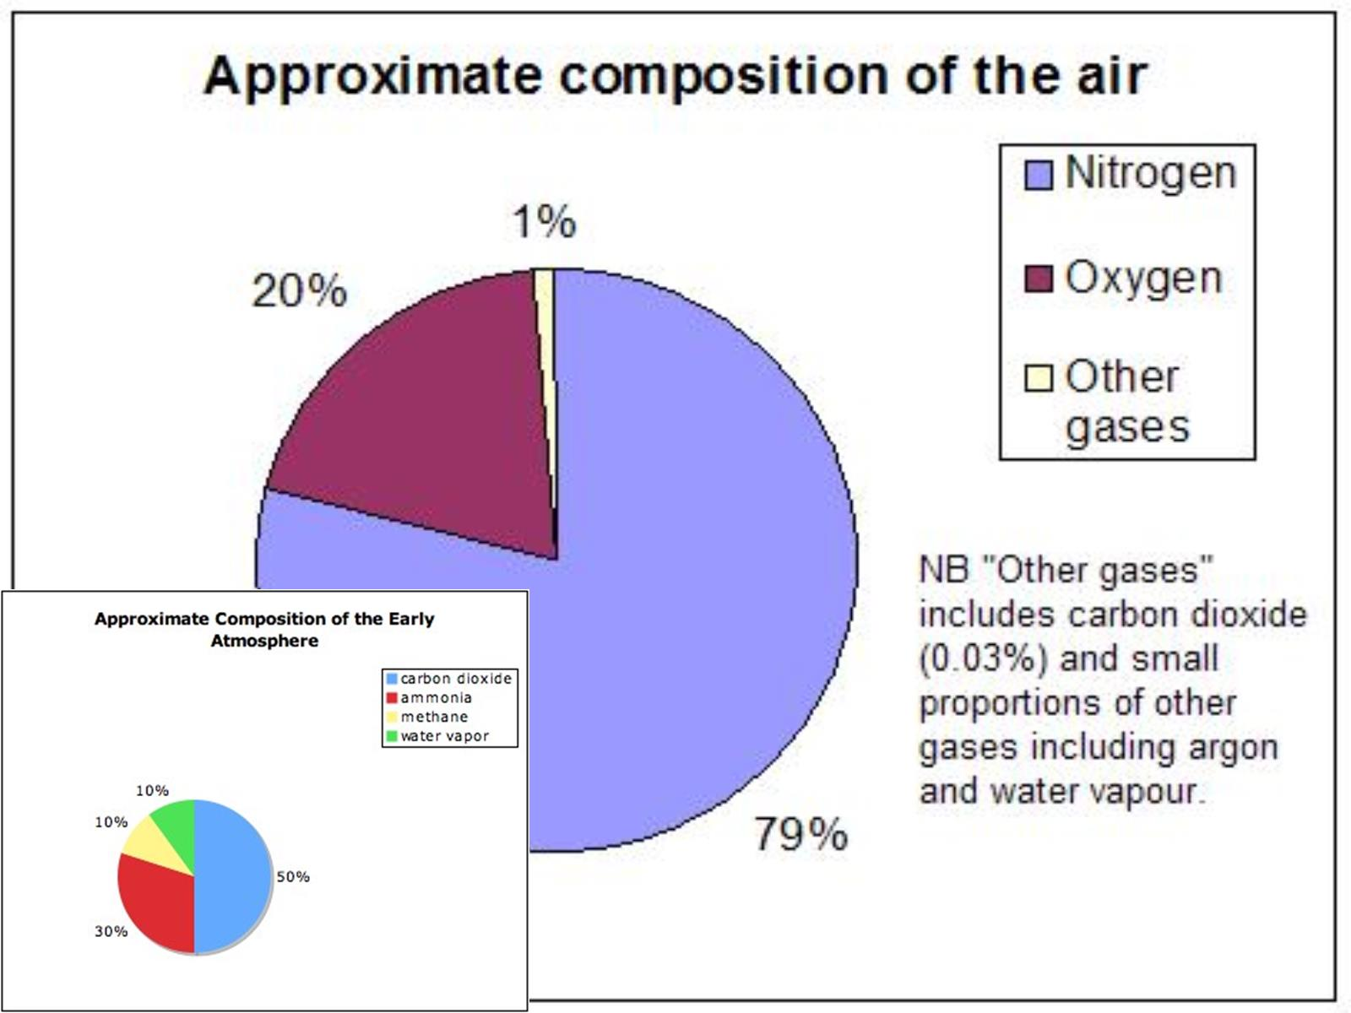

Slide 8
Our Atmosphere is constantly changing . . .

Slide 9
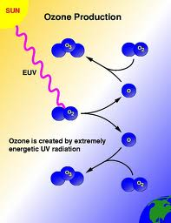
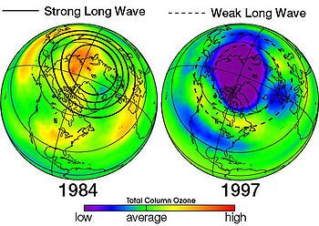
CFC’s are compounds that come from man-made materials (sprays, styrofoam, etc.) , which break bonds between the oxygen in ozone molecules.
This creates “holes” in our ozone layer, which protects us against radiation from the sun and space.

Slide 10
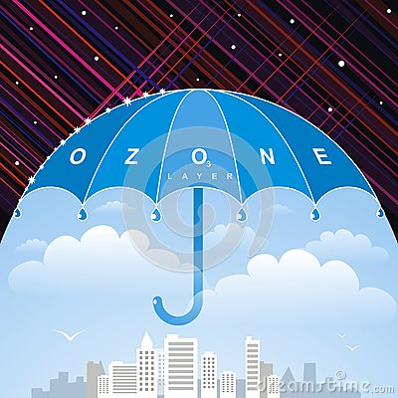
Ozone (O₃)
Ozone blocks most of the sun’s UV rays, protecting our skin
Only 3 out of every 10,000,000 molecules is O₃, but that’s enough to block the radiation

Slide 11
How can I remember the layers of the atmosphere?

Slide 12
Our atmosphere is always changing…
PHOTOSYNTHESIS uses Carbon Dioxide and creates Oxygen as a by-product
RESPIRATION uses up Oxygen to digest food, and creates Carbon Dioxide
POLLUTION from cars, forest fires, and manufacturing add many other chemicals
Carbon dioxide traps heat in the atmosphere
RAIN removes some pollution from the air

Slide 13
The Layers of the Atmosphere

Slide 15
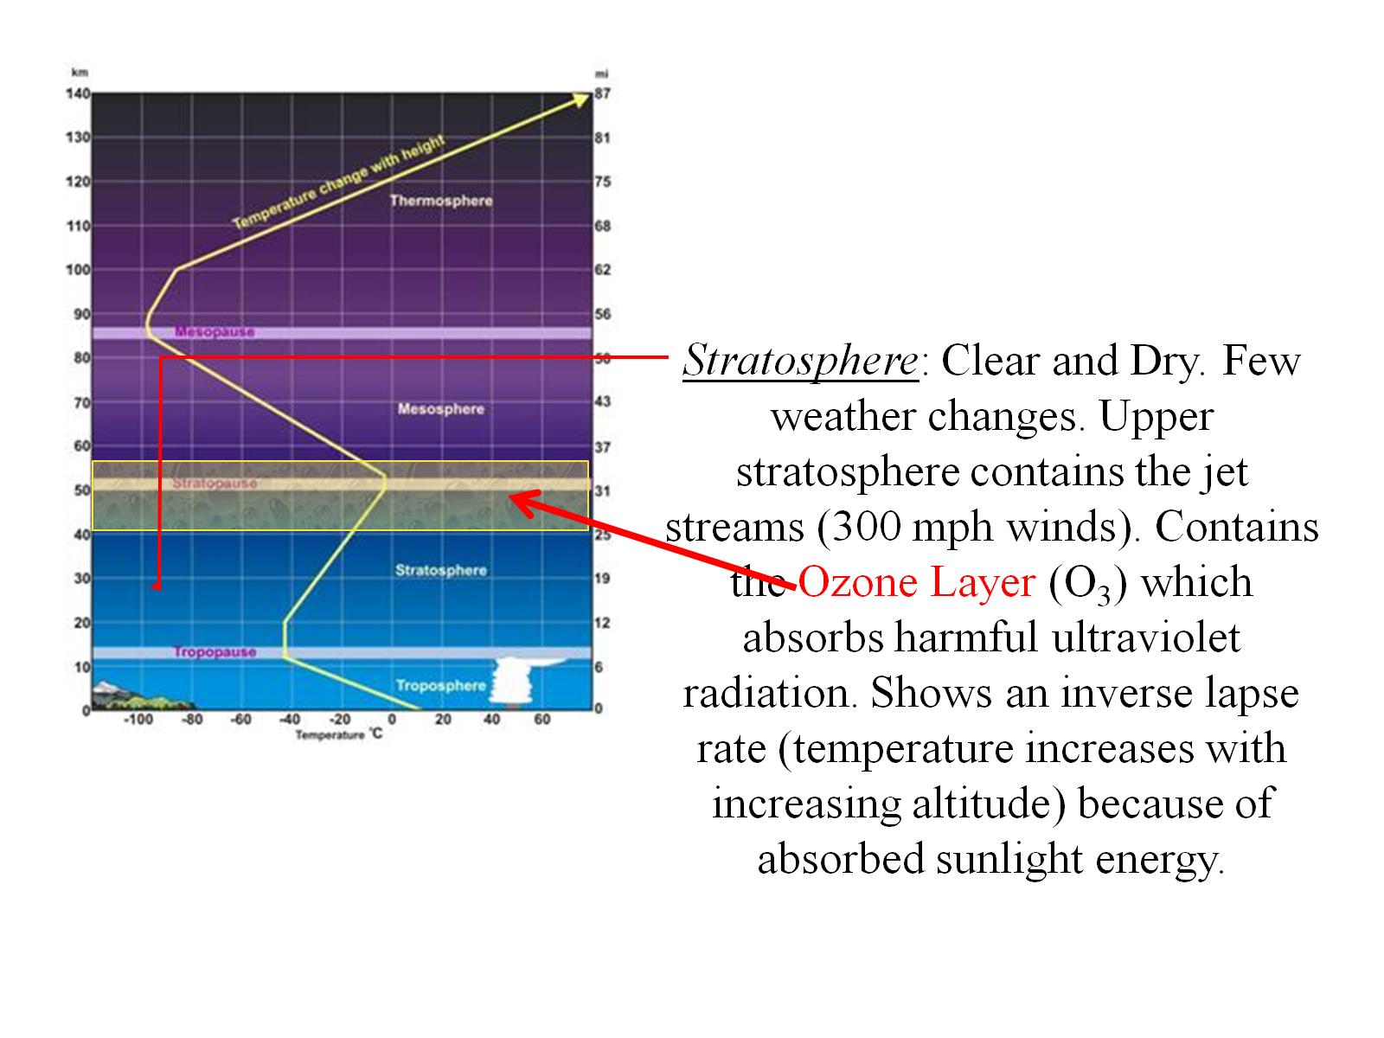

Slide 18
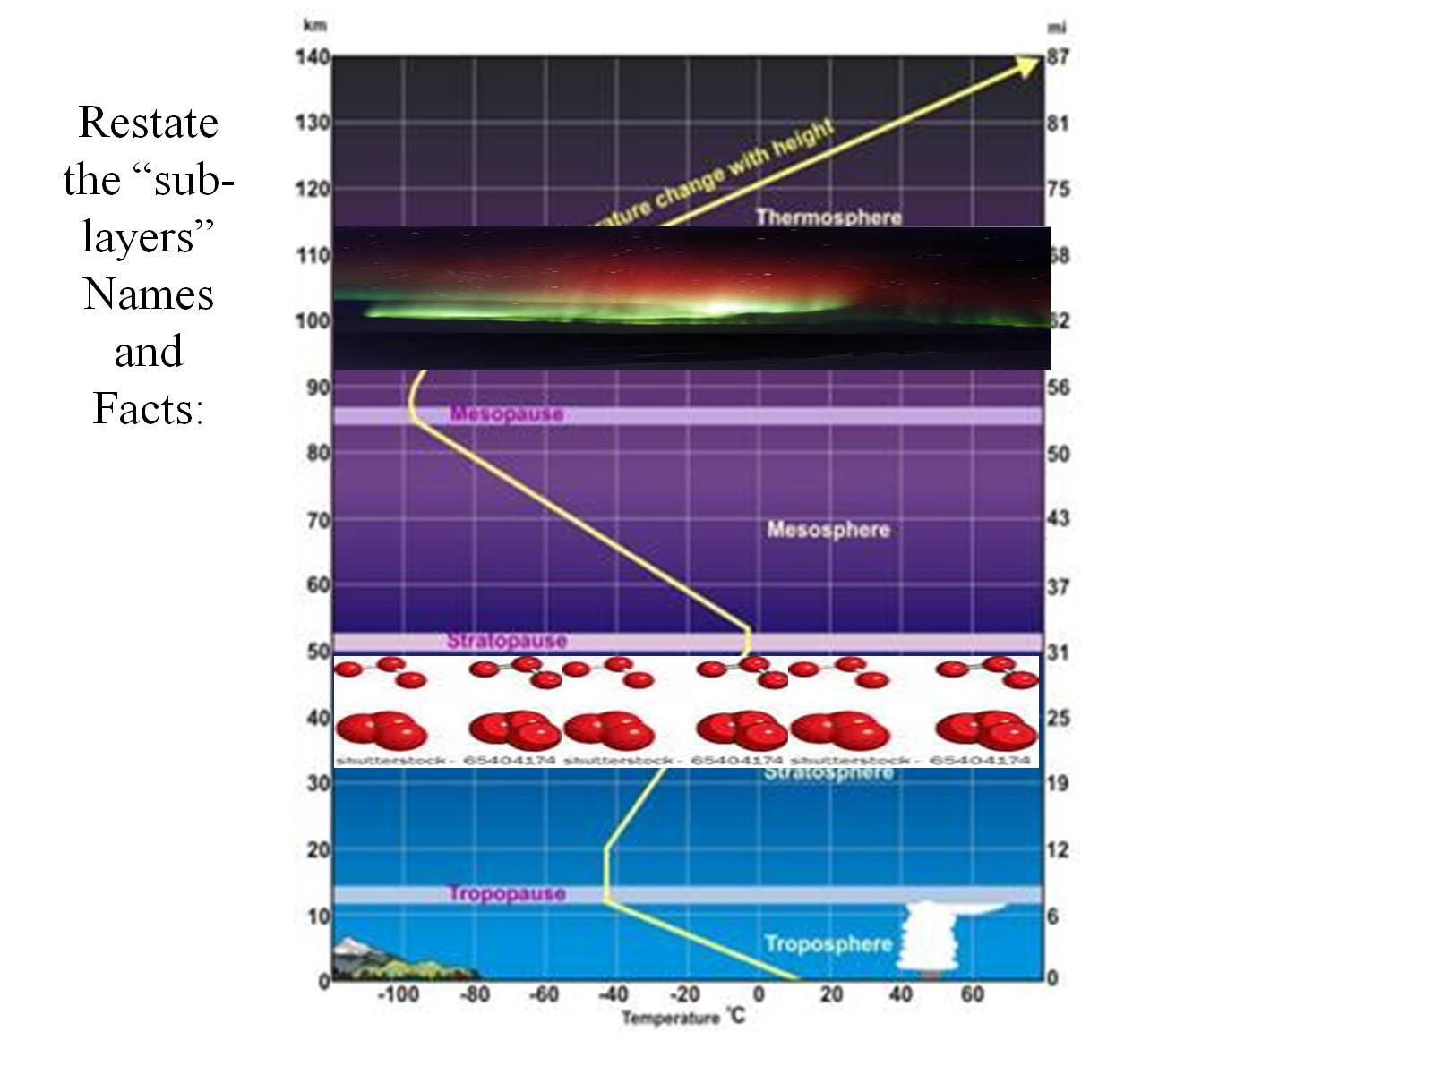

Slide 19
Can you locate the following?
the Ozone Layer is in the …
the Ionosphere is in the …
Outer Space is also called the …

Slide 20
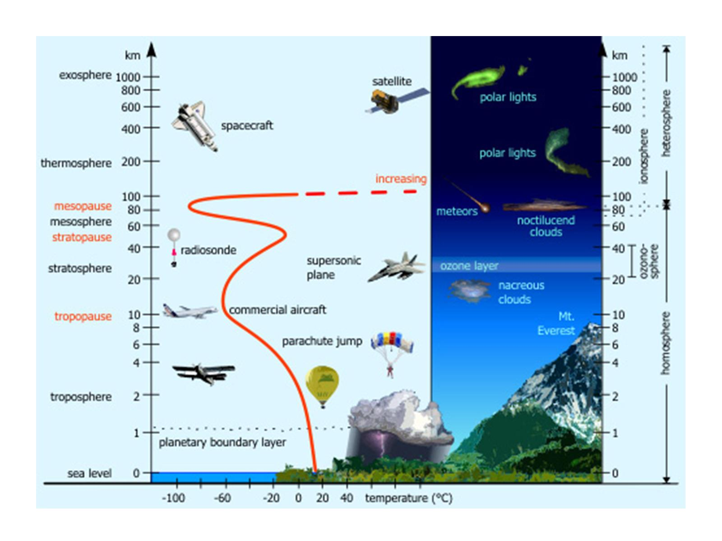

Slide 21
https://www.youtube.com/watch?v=3CerJbZ-dm0

Slide 23
