Slide 1
SCIENCE FINAL REVIEW
Board Wars!!!!!!!!

Slide 2
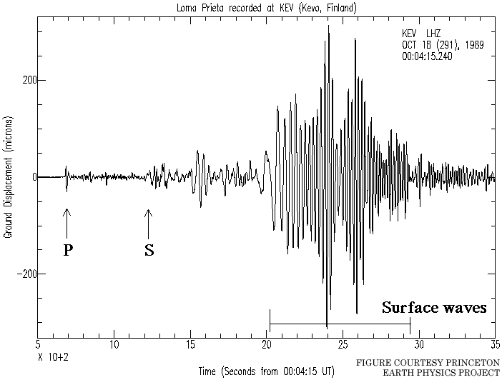
What is the arrival time of the P wave below?

Slide 3
What is the arrival time of the S wave below?

Slide 4
What is the LAG TIME of the earthquake?

Slide 5
What does the word “MAGNITUDE” mean?
Force
Area affected
Distance
Amplitude height

Slide 6
What kind of earthquake waves get there last?
(S Waves, Surface Waves, P waves)

Slide 7
What kind of slower waves oscillate up and down (at right angles to the ground)? (S Waves, Surface Waves, P waves)

Slide 8
What is this layer of the earth called, that is molten, part of the upper mantle, and has convection currents that move plates?

Slide 9
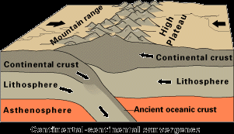
What kind of plate boundary is this, which forms the Himalayas?( say “oo,oc, or cc” and say “convergent, divergent, or transform”)

Slide 10
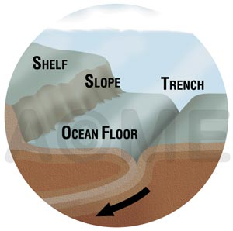
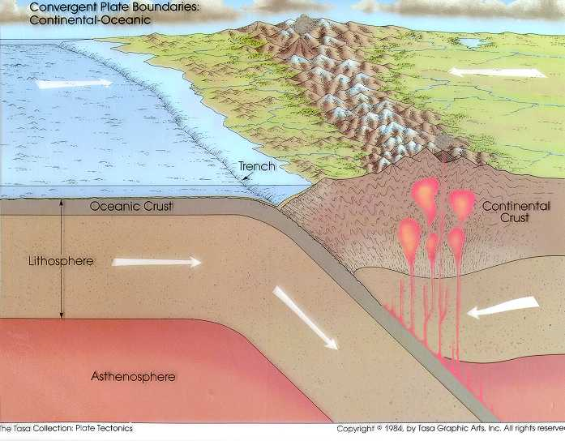
Name one SIMILARITY and one DIFFERENCE in both of these plate boundaries:

Slide 11
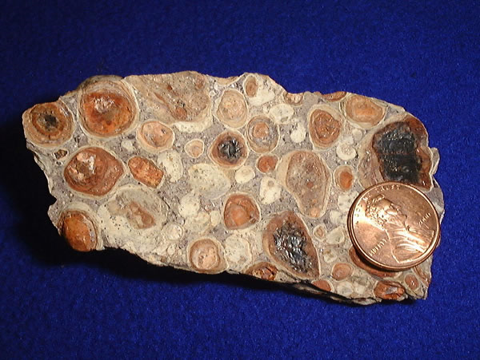
Bauxite is an ______ of Aluminum, since you can mine it for a profit.

Slide 12
This is Vinegar (Acetic Acid): CH3 COOH
Is it a molecule or a compound?
What are the elements that make Vinegar?

Slide 13
Which test below is not for minerals?
Streak
Hardness
Acid
Specific Gravity (Density)
Water content
Breakage (cleavage/fracture)

Slide 14
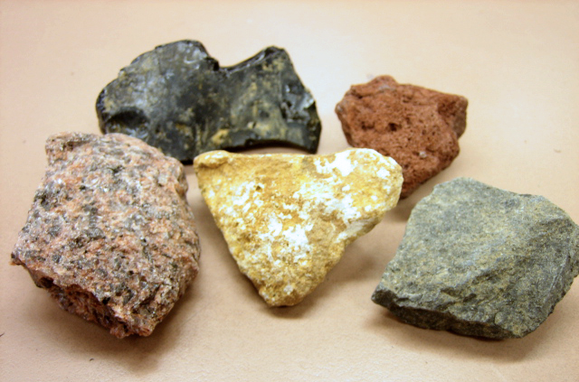
Fill out the names of the 3 major rock types according to their classes:
__________ (Foliated, Non-foliated)
__________ (Clastic, Chemical, Organic)
__________ (Intrusive, Extrusive)

Slide 15
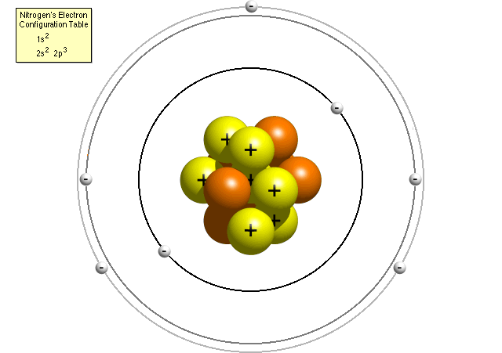
Name the parts of this atom by color:

Slide 16
1) What’s the atomic number of this atom? 2) What is the name of this atom ?

Slide 17
What is the number of neutrons of this atom?

Slide 18
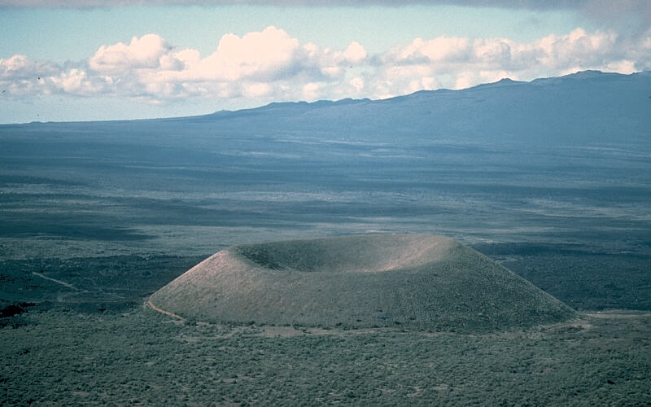
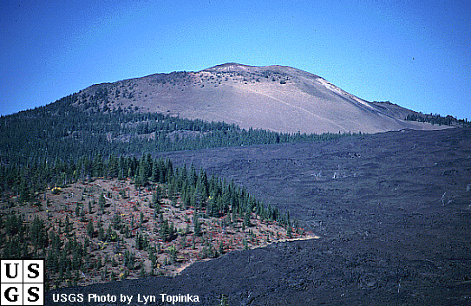
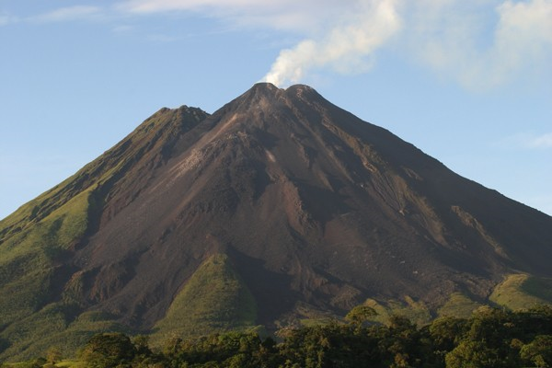
Write the names of the 3 volcano types below by number:
1) 2)
3)

Slide 19
Write the names of the 3 eruption behaviors (quiet, violent, alternating) below by number:
1) 2)
3)

Slide 20
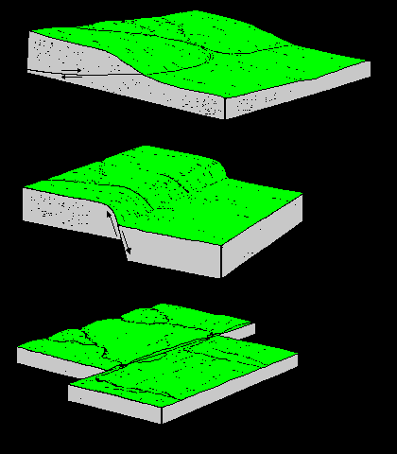
Write the names of the 3 fault types by number:
1)
2)
3)

Slide 21
Write the names of the 3 plate boundaries you would find these by number:
1)
2)
3)

Slide 22
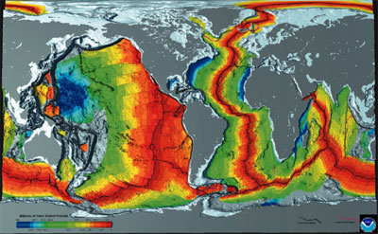
What are these called? What do they provide evidence for?

Slide 23
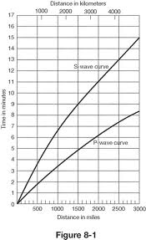
What is the LAG TIME on this graph if you are 1500 miles away from the epicenter?

Slide 24
Match the scale type with what it measures:
Distance to epicenter of earthquake
Earthquake damage done
Magnitude / Force of strongest waves
Mercalli (Rossi-Forel)
Richter
Seismograph

Slide 25
What’s the difference between the focus and epicenter?

Slide 26
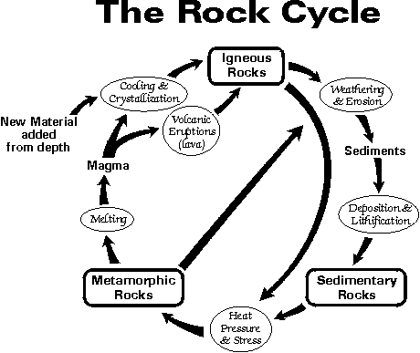
What 4 events have to happen to a rock to change from Metamorphic to Sedimentary?

Slide 27
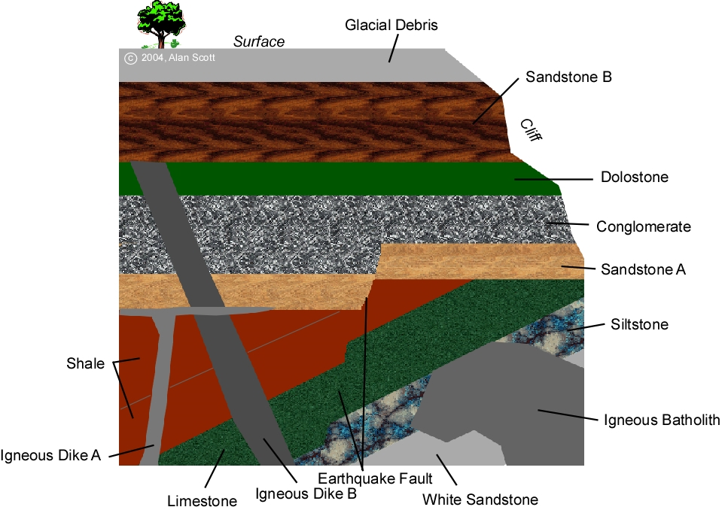
Is Conglomerate or Siltstone older?

Slide 28
Is Igneous Dike A or B older?

