Slide 1
HR Diagram

Slide 2
Some STAR characteristics are:
Magnitude: How bright a star ranks on a numerical scale ( - is bright, + is dim)
Luminosity: Energy output of a star in Watts (just like a lightbulb)

Slide 3
SPECTRAL CLASS: Categories of age, color, and temperature
Spectral Class categories: O, B, A, F, G, K, M
[Oh Be A Fine Girl, and Kiss Me ]

Slide 4
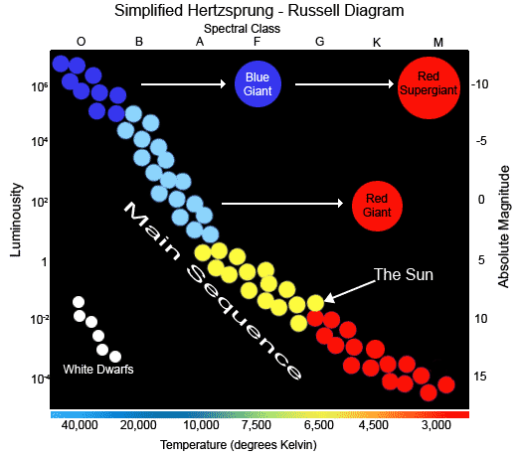
The Hertzsprung-Russell Diagram is a scatter plot that is 4-directional: it tells you the spectral class, magnitude, power, and temperature of a star.

Slide 5
Is a Red Supergiant or a White Dwarf brighter?

Slide 6
Is a Blue Dwarf or a White Dwarf hotter?

Slide 7
Is a reddish main sequence star or the sun younger?

Slide 8
Does a Red Giant or a Blue Giant generate more power from fusion?

Slide 9
What spectral class does White Dwarf stars belong to?

Slide 10
Describe 3 pieces of information about the sun from this diagram:

