Slide 1
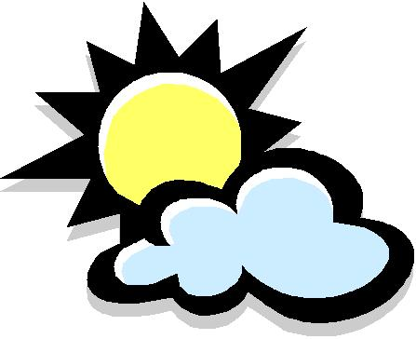
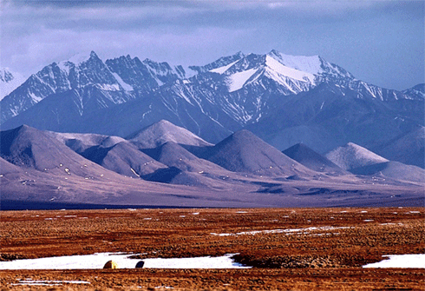
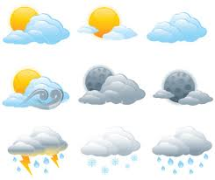
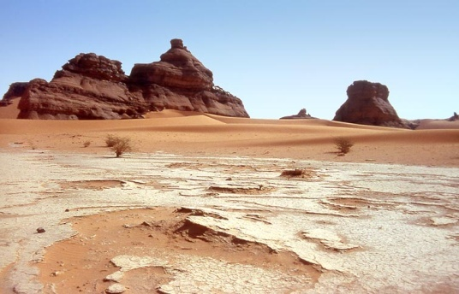
Meteorology
12.1: The Causes of Weather
12.2: Weather Systems
Weather
Climate

Slide 2
Sun’s Rays & Angle of Incidence
Summer
EQUATOR
HIGH NOON
Earth
© 2001 D. L. Power
Winter

Slide 3
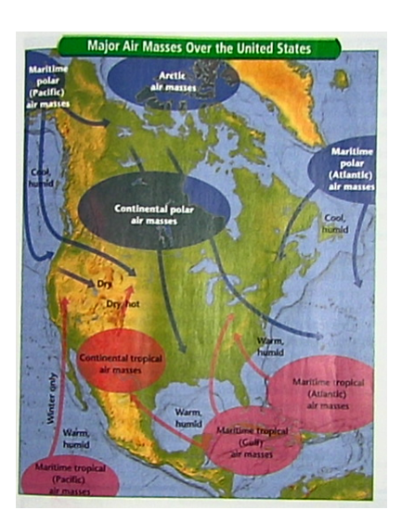
AIR MASSES
Air Masses are large bodies of air that take on the characteristics of the area over which it forms.
For example, air masses that form over the ocean are moist. If they form over land, they are dry. The air also takes on the temperature of the area.
Land = Continental
Ocean = Maritime

Slide 4
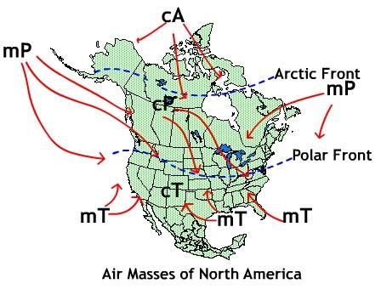
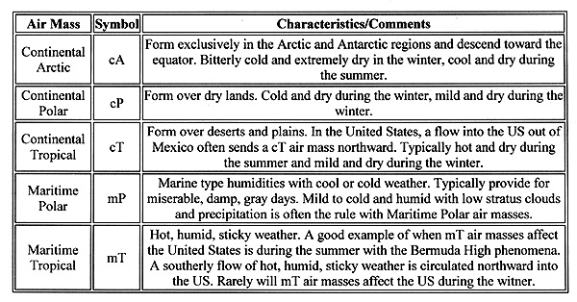

Slide 5
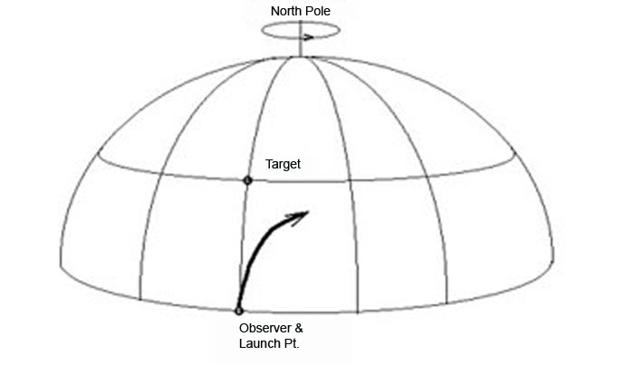
The Coriolis Effect
Moving particles are deflected due to the rotation of the Earth
The combination of the Coriolis effect and the uneven heating of the Earth creates global wind systems.
The Coriolis Effect
Coriolis Effect Animation

Slide 6
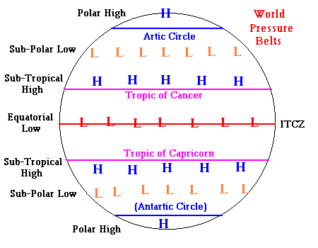
World Pressure Belts

Slide 7
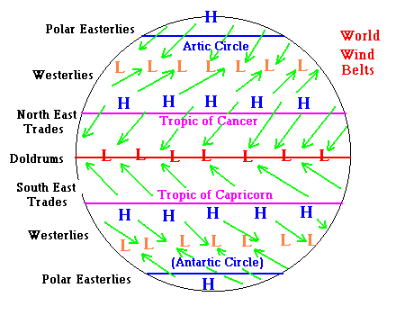
an
Wind Animation

Slide 8
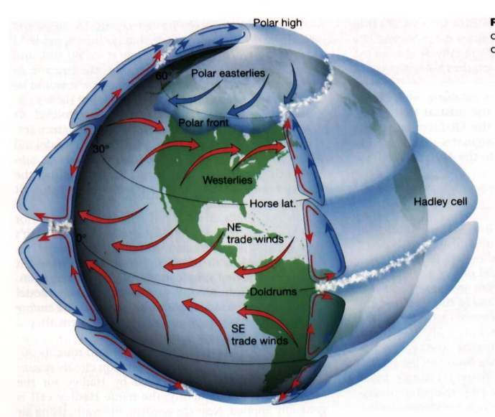
We also see convection at work in many of the winds that occur in the troposphere . . . .
Animation
Westerlies are smaller, surface winds that affect
a lot of our weather patterns in the US
All of these TRADE WINDS change direction, because
Of the angle of sunlight
At each latitude.
There is even a giant convection cell between the equator and poles!

Slide 9
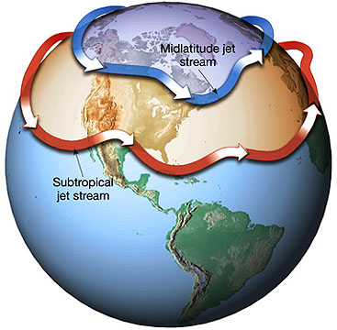
. . . And also above the troposphere . . .
Jet Streams are larger winds that push California’s weather almost always in a
WEST-TO-EAST direction.

Slide 10
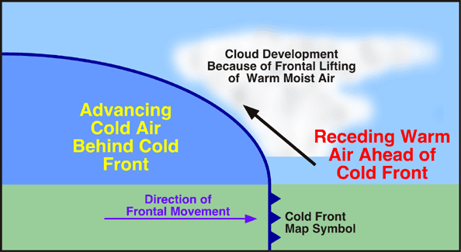
Cold Front
Cold dense air hits a mass of warm air shoving the warm air up quickly. Clouds, rain and even thunderstorms result.
http://www.classzone.com/books/earth_science/terc/content/visualizations/es2002/es2002page01.cfm?chapter_no=visualization

Slide 11
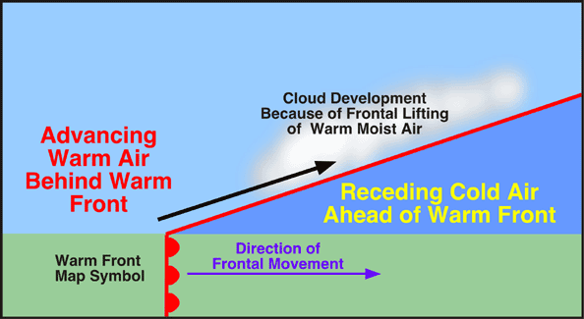
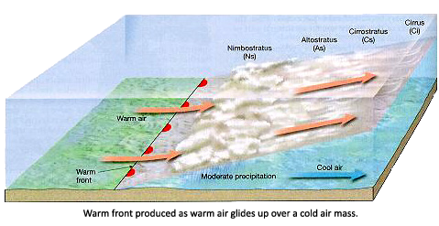
Warm Front
Advancing warm air meets cold air. Warm air moves slowly up and over the cold air mass. A “parade of clouds” forms.
http://www.classzone.com/books/earth_science/terc/content/visualizations/es2002/es2002page01.cfm?chapter_no=visualization

Slide 12
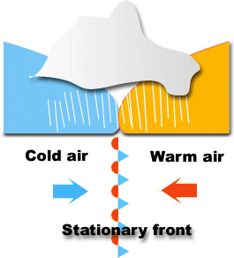
Stationary Fronts
When two air masses meet with little difference between their temperatures. Neither mass moves. Also called a “Stalled Front”

Slide 13
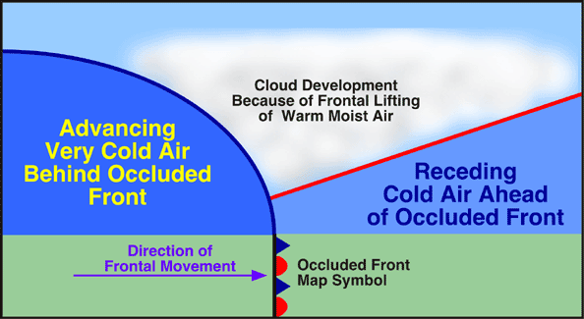
Occluded Front
When a cold front moves so quickly that it overtakes a warm air mass and hits another cold air mass. The warm air mass is thus “squeezed out” . It rains on both sides of an occluded front.

Slide 14
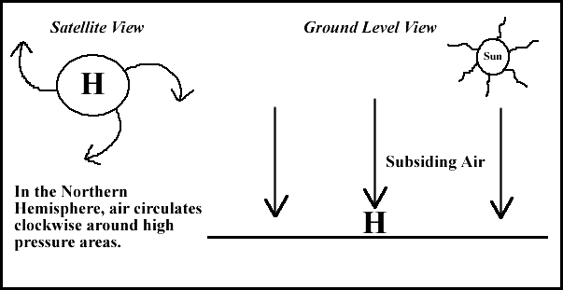
High Pressure Systems
NICE
WEATHER!
High Pressure – Air is Falling. In the N. Hemisphere the air moves in a clockwise direction OUT from the center. (S. Hemisphere it moves counter-clockwise)

Slide 15
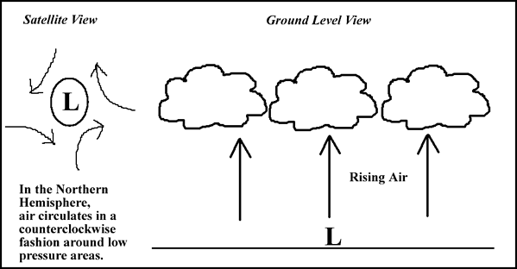
Low Pressure Systems
Low Pressure – Air is Rising. In the N. Hemisphere the air moves in a counter-clockwise direction INTO the center. (S. Hemisphere it moves clockwise)

Slide 16
Larger Scale Winds – Monsoons
A monsoon develops according to the same principles as land and seas breezes but on a large scale - a subcontinental scale.
A monsoon is typically associated with India and its surrounding countries, but a monsoon may also provide moisture to the deserts of the Southwest United States in the summer. With respect to the Indian subcontinent, there are two types of monsoons - a Southwest Summer Monsoon and a Winter Northeast Monsoon.

Slide 17
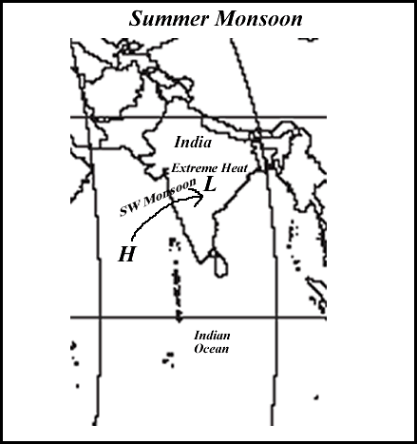
Over India during the Summer, it becomes extremely hot (i.e. 40 degrees Celsius). This extreme heat generates low air pressure. In contrast, the Indian Ocean is relatively cooler and therefore has relatively higher air pressure.
Consequently, the air starts to move
from the ocean to the land as this
pressure differential is established.
This is the onset of the monsoon
season which brings torrential
precipitation as moisture laden air
moves onshore.

