Slide 1
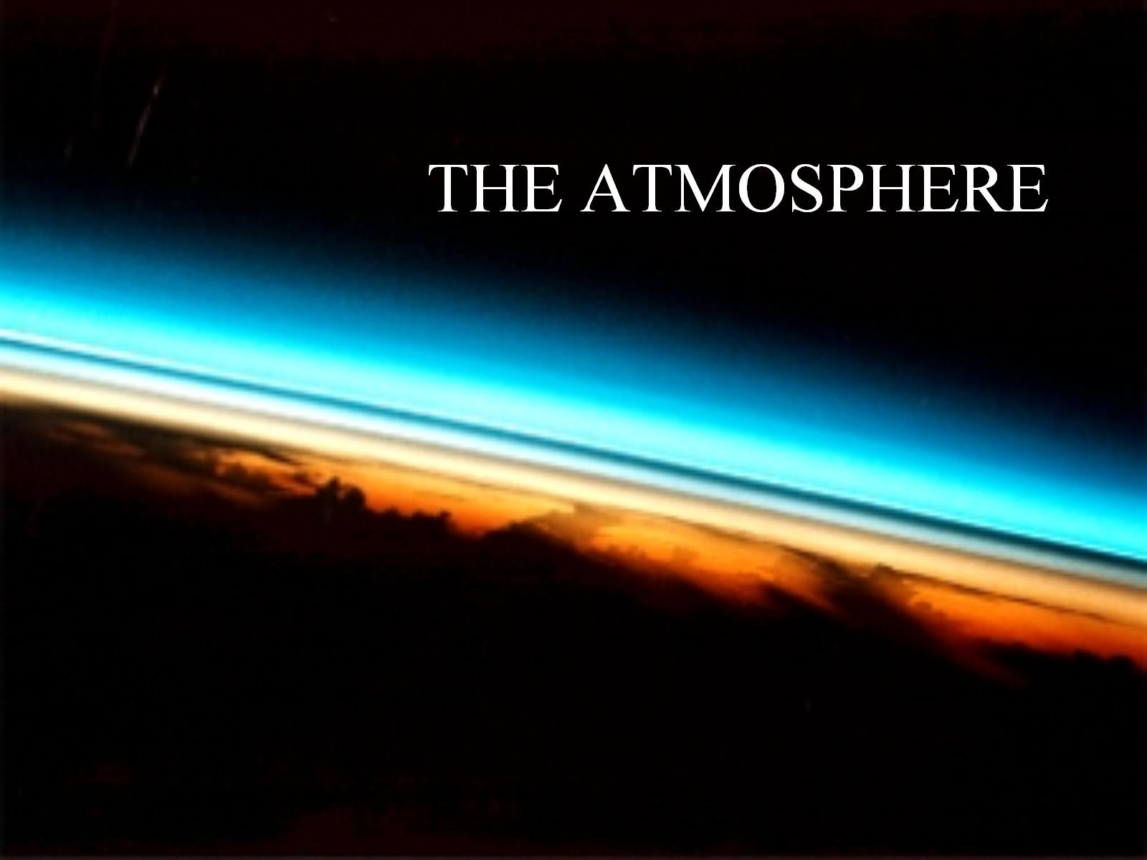
THE ATMOSPHERE

Slide 2
Without an atmosphere that had a specific design, life would not be possible on earth.

Slide 3
Our ancient climate was very different from today’s . . .

Slide 4
Our ancient climate was very different from today’s . . .

Slide 5
Our ancient climate was very different from today’s . . .

Slide 7
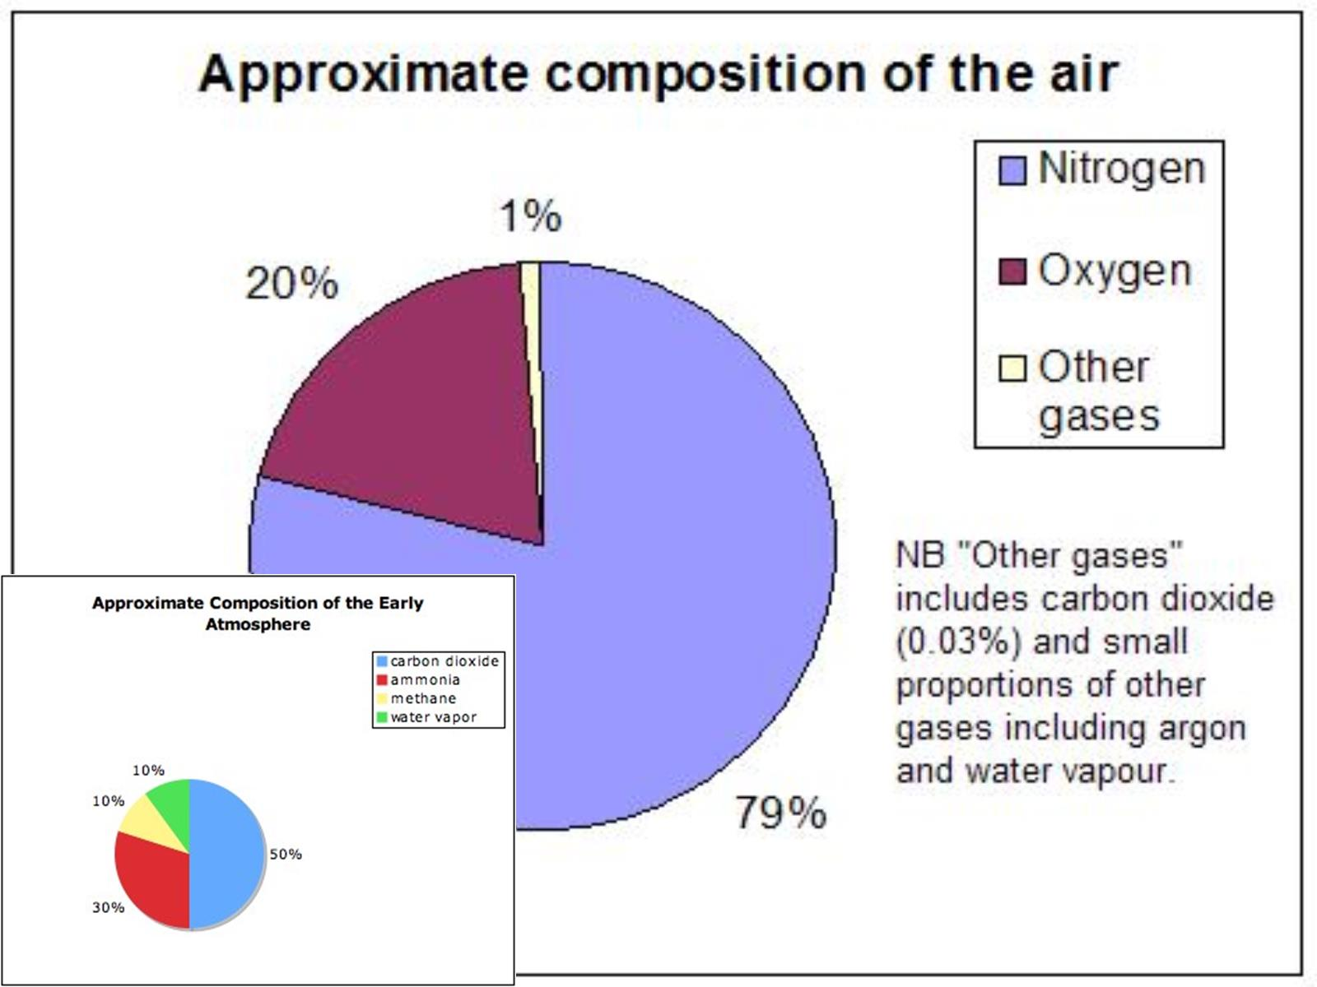

Slide 8
Our Atmosphere is constantly changing . . .

Slide 10
The Layers of the Atmosphere

Slide 12
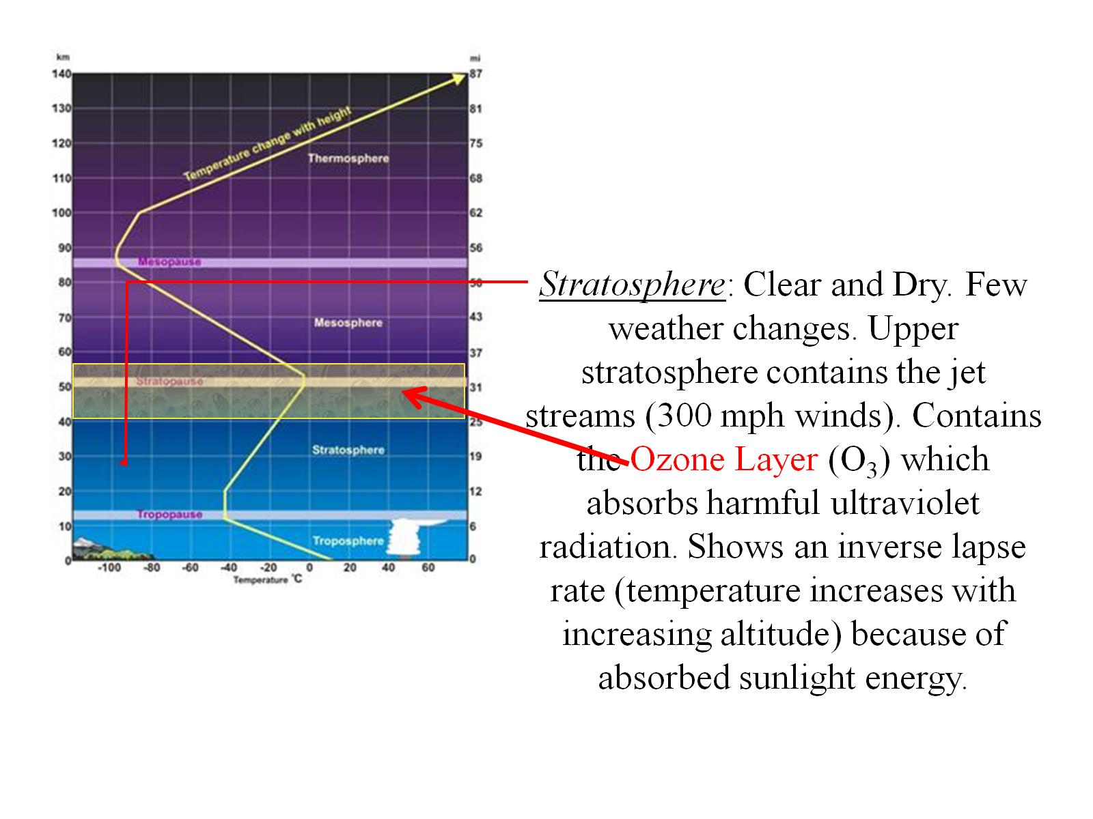

Slide 15
How can I remember the layers of the atmosphere?

Slide 16
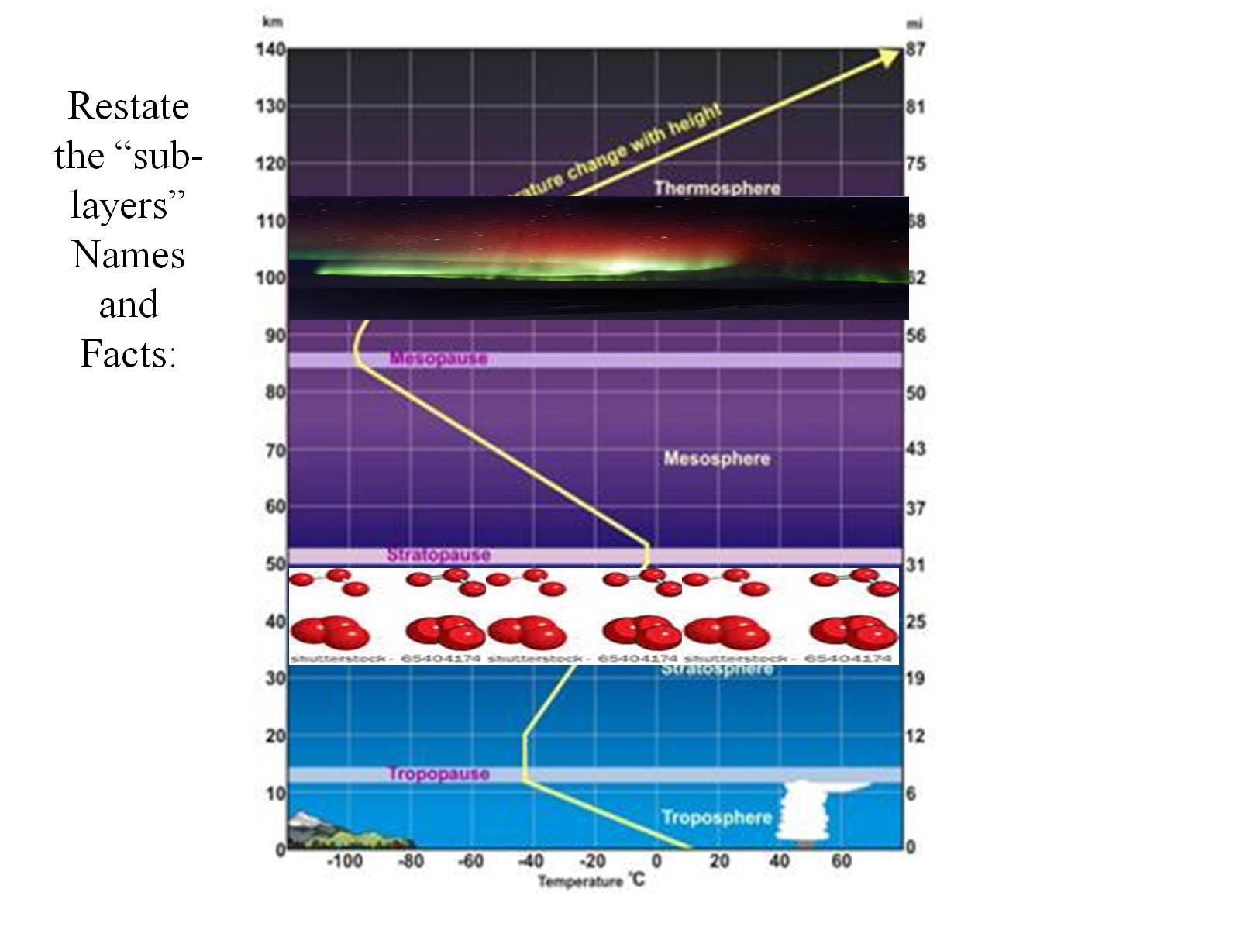

Slide 17
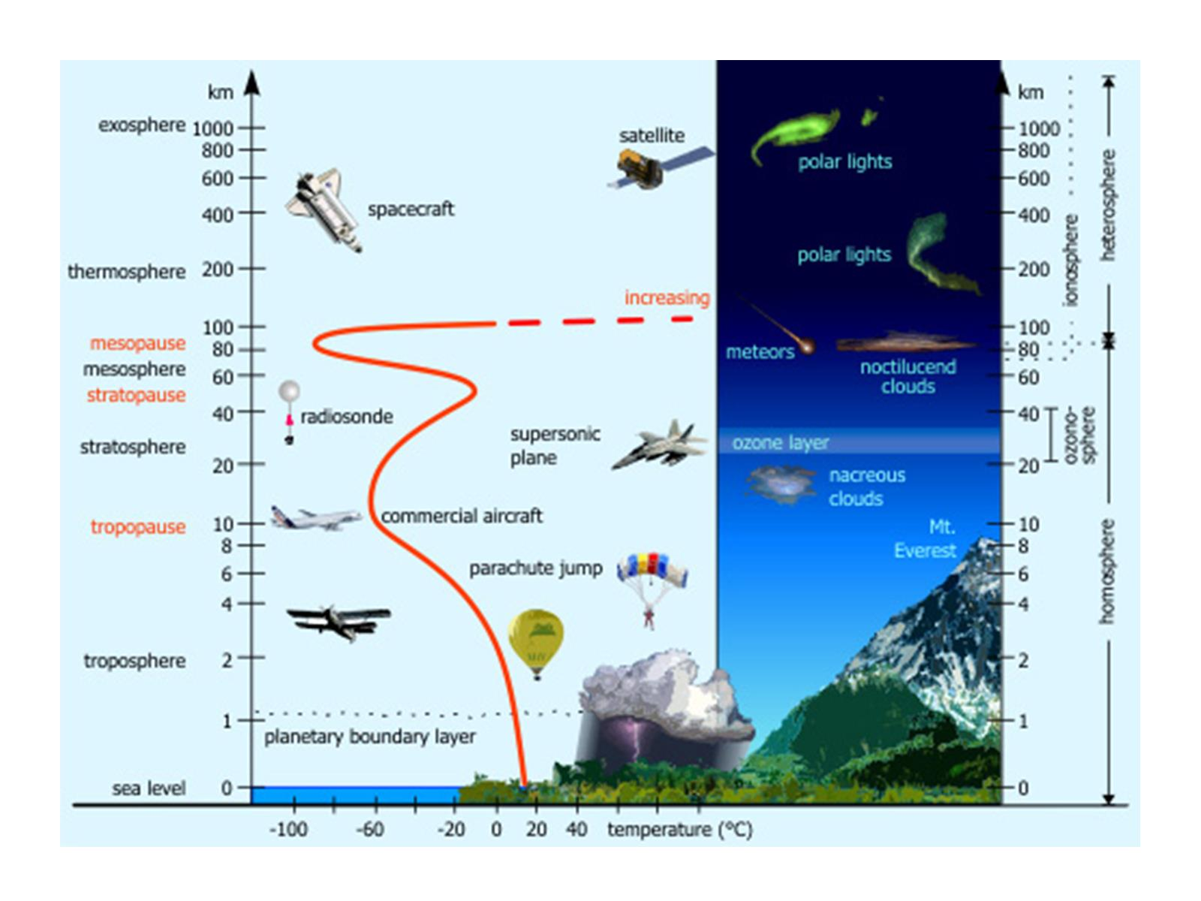

Slide 19
