Slide 1
Star Chemistry and Measurement

Slide 2
Some STAR characteristics are:
Absolute Magnitude: How bright a star is compared to other stars at the same distance away.
Apparent Magnitude: How bright a star ranks on a numerical scale ( - is bright, + is dim)
Luminosity: Energy output of a star in Watts (just like a lightbulb)

Slide 3
Examples: Apparent: “The moon has a magnitude of -13”. Absolute: “I can see in the sky tonight that the moon is brighter than Venus”

Slide 4
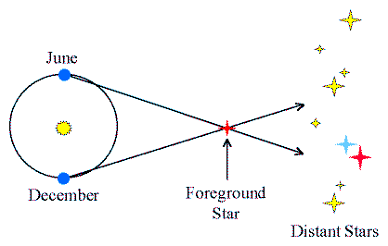
“PARALLAX” happens when viewing stars, and “RETROGRADE MOTION”. Happens when viewing planets . .
PARALLAX:
When viewing a star from a fixed position , it appears
To change places in the sky (the farther away the star, the less movement you see) **FINGER/NOSE EXAMPLE**

Slide 5
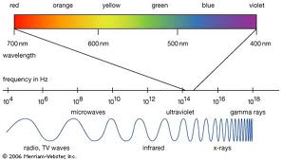
A scale of different types of Energy Waves in order of high frequency to low frequency, is called the EM Spectrum.
LOW
ENERGY
(ABLE TO BE
SEEN, HEARD,
Or FELT)
HIGH
ENERGY
(DAMAGE TO ATOMS)

Slide 6
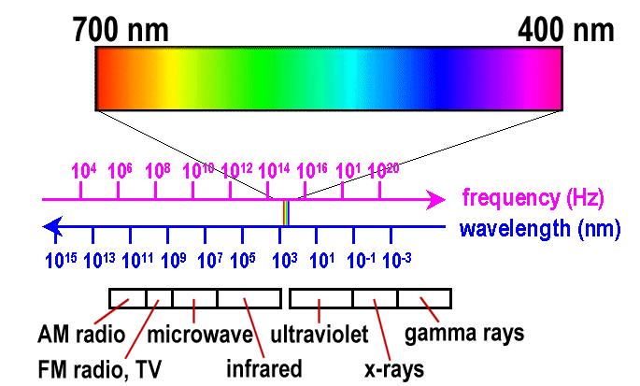
“ROYGBIV” : an acronym for visible waves of energy that we are able to see as colors from low energy to high. )

Slide 7
Which color has more energy. . . Orange or green?

Slide 8
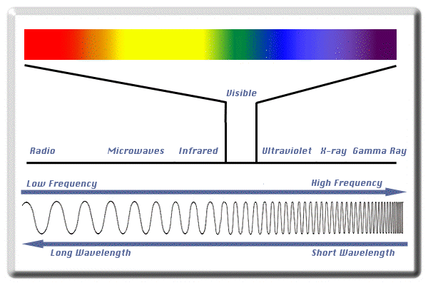
The reason you see a lot of reds, oranges, etc. at sunset is because those are the only long, stretchy wavelengths of light that can squeeze through dirt in the atmosphere and get to your eye.
R O Y G B I V

Slide 9
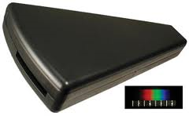
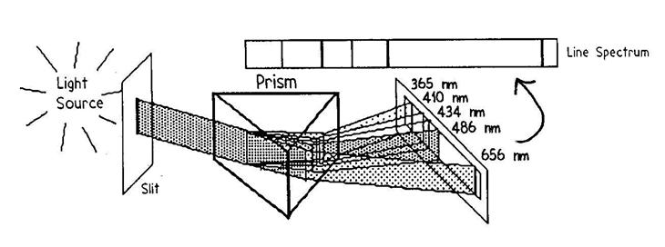
When viewing the light coming from a stubstance, you can look at it with a Spectroscope. This is a tube with a diffraction grating in it, that splits the mixed light into separate wavelengths. Each wavelength indicates the presence of a certain element, like a finger print. EX

Slide 10
When you energize a substance with electricity, you make electrons jump up to higher shells. When they calm down again, a photon of light is released. . .

Slide 11
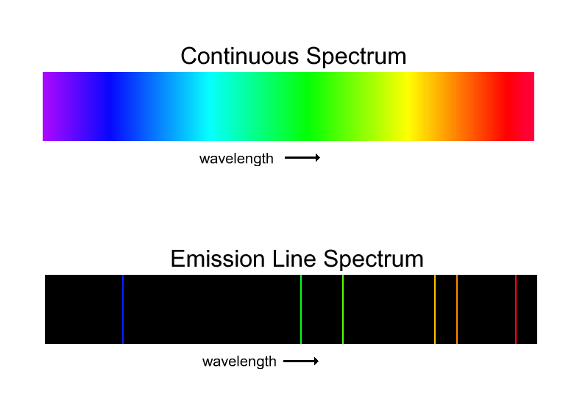
Here’s the PHOTON ENERGY (Spectra) of most substances . . .
SOLIDS and
LIQUIDS:
GASES:
(Why do you think they look so different? )

Slide 12
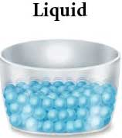
NOW SAY WHY ? . . .

Slide 13
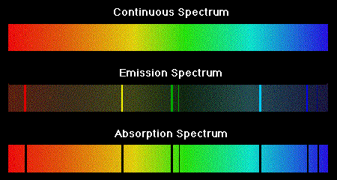
The bottom is what it would it look like to view spectra of a solid/liquid when gas is blocking your view. Explain.

Slide 14
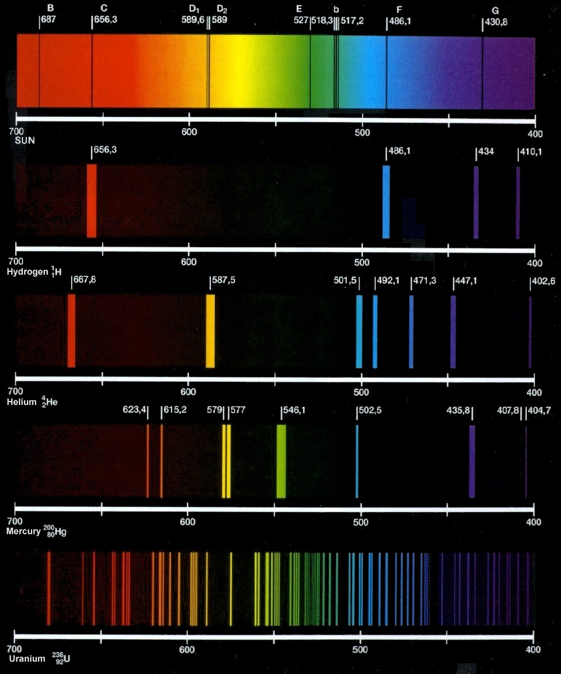
SPECTRA gives us STARRY inFORMATION!
By looking at the Emission Spectra of far away stars, we can tell the following about them:
What they’re made of
If they’re moving, how fast, and where to
What cycle of life they’re most likely in

Slide 15
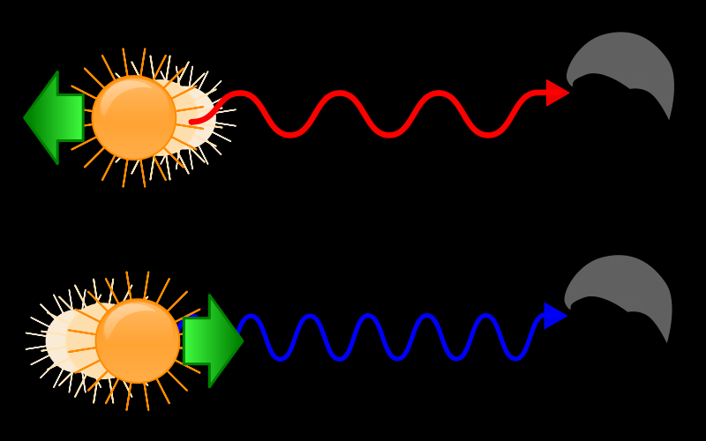
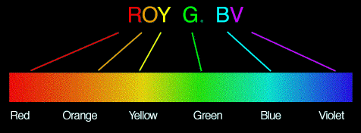
If stars in space are moving, you will see a DOPPLER SHIFT in waves. (Red = moving away, blue = moving towards)

Slide 16
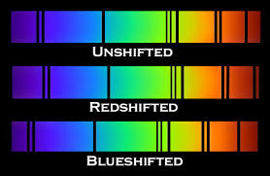
This means the whole spectra pattern will get pushed towards the red end or the blue end of the scale. . .

Slide 17
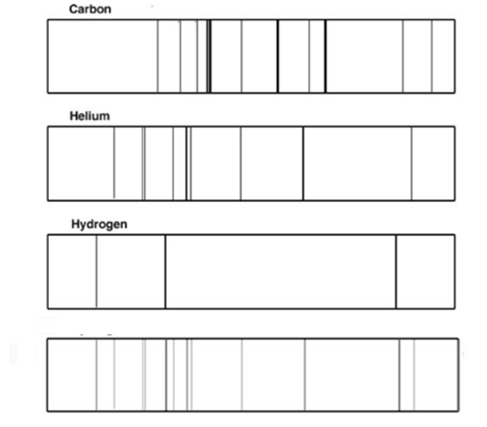
What chemicals are present in the star at the bottom?

Slide 18
SPECTRAL CLASS: Categories of age, color, and temperature
Spectral Class categories: O, B, A, F, G, K, M
[Oh Be A Fine Girl, and Kiss Me ]

Slide 19
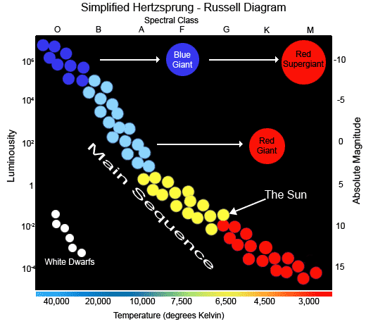
The Hertzsprung-Russell Diagram is a scatter plot that is 4-directional: it tells you the spectral class, magnitude, power, and temperature of a star.

Slide 20
Is a Red Supergiant or a White Dwarf brighter?

Slide 21
Is a Blue Dwarf or a White Dwarf hotter?

Slide 22
Is a reddish main sequence star or the sun younger?

Slide 23
Does a Red Giant or a Blue Giant generate more power from fusion?

Slide 24
What spectral class does White Dwarf stars belong to?

Slide 25
Describe 4 pieces of information about the sun from this diagram:

