Slide 1
Week 12 Thursday / Friday
Warm-Up – Have you been in a carnival ride standing up that spins really fast? Describe how it felt.
Learning Goals
#1- Be able to explain tidal force.
#2- Diagram solar and lunar positions and the type of tides they will create.

Slide 2
During the video – Listen for the following:
Where is the center of mass?
Draw a circle and an oval on your page

Slide 3
Define Tidal Force
What does Tidal force do to an object?
Name 3 things it depends on…
1.
2.
3.

Slide 4
A few more questions…
Does the earth pull on the Moon?
What is Tidal Lock?
How does the gravity of the Sun compare with the gravity of the Moon?

Slide 5
Crash Course #8 TIDES
https://www.youtube.com/watch?v=KlWpFLfLFBI&t=224s

Slide 6
Where is the center of an object?
One way to think of the center of mass of an object is the average position in an object of all its mass
The overall effect of the tidal force is to stretch an object.

Slide 7
Gravity Tidal Force
Tidal Force is the change in the force of gravity over distance.
And the depends on several things:
How strong the object’s gravity is…
How wide the 2nd object is…
The distance between the two objects…

Slide 8
Which tide is this?
Does this tide happen during the New Moon?
Does this tide happen during the Full Moon?
Which Moon will bring the highest high tides?

Slide 9
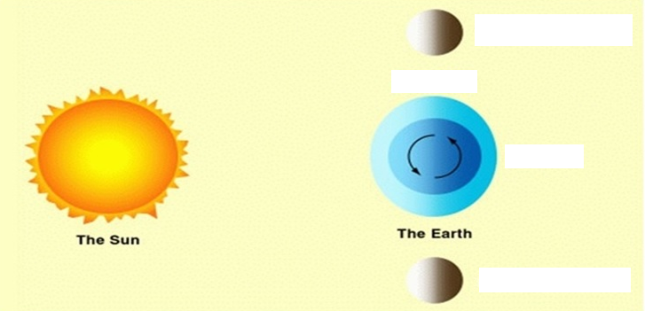
Which tide is this?
What tide happens at the top and the bottom of earth?
This tide happens at what Moon phases?
Do the two phases of the Moon create different tides?

Slide 10
Spring Tide

Slide 11
Neap Tide

