Slide 1
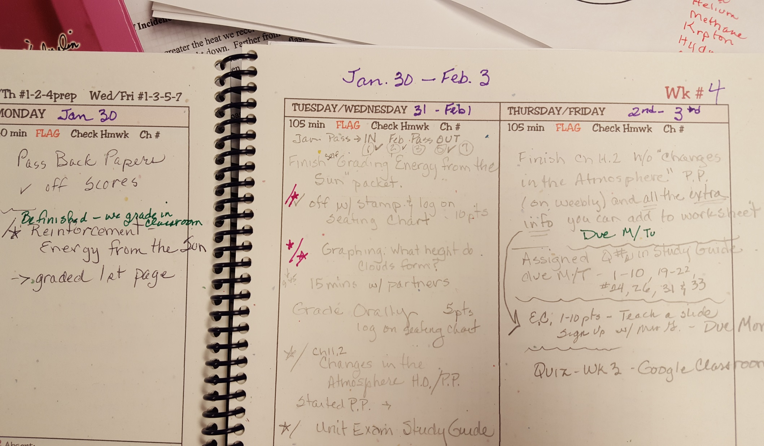
Week 4 Jan.30 – Feb 4

Slide 2
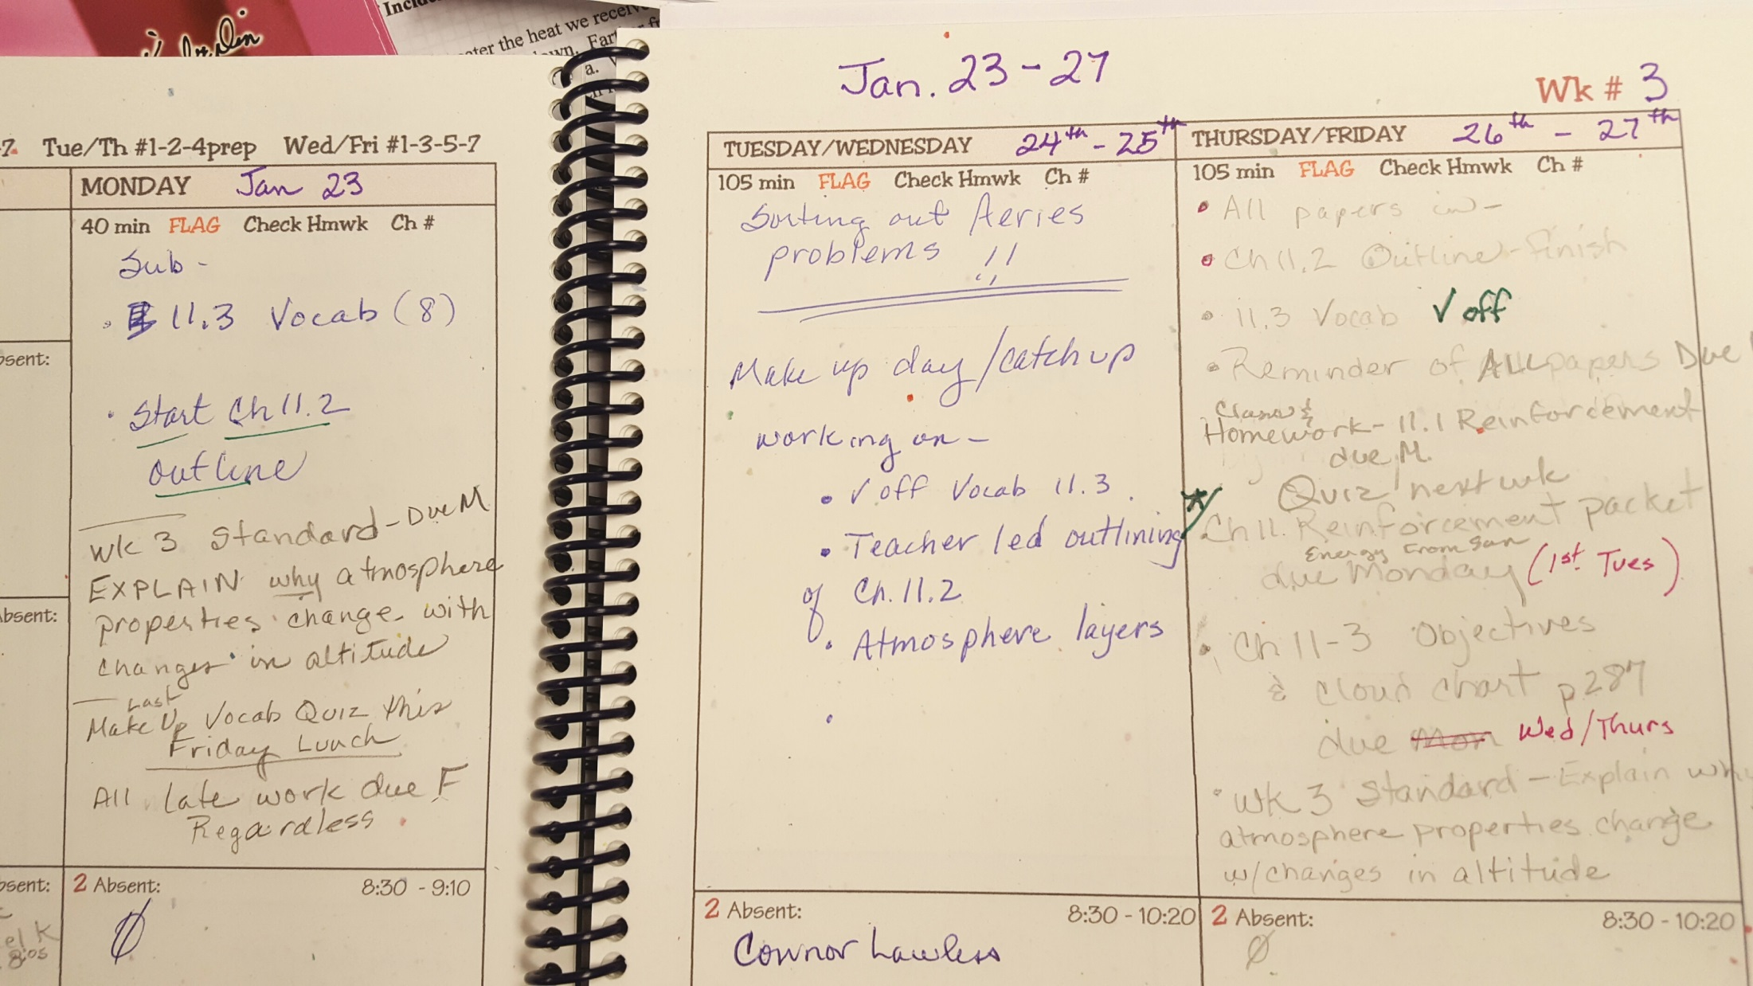
Week 3 Jan. 23 – Jan. 27

Slide 3
Week 2 Jan 17-20

Slide 4
Week 1 Planner & Standards Jan 9 - 13

